Slide 1
Chapter 7
The “Emacs“ Editor

Slide 2
Topics
About emacs
Getting Started: Creating and Editing
Introduction to emacs Features
Command Mode –
  Moving the Cursor
  Changing text

Slide 3
About emacs
Created in 1975 by
Richard Stallman
Guy Steele &
John McCarthy of M.I.T.
  Originally an extension to TECO
  (Circa 1960, Text Editor & Corrector)
  emacs (editor macros)

Slide 4
About emacs
“Emacs is the extensible, customizable, self-documenting real-time display editor.”
“emacs manual”

Slide 5
About emacs
emacs is not vim
  modeless editor unlike vim
  edit files in buffers like vim
  switch between buffers without writing them out & reading them back in.
  display multiple buffers simultaneously
  Set your own command environment

Slide 6
Getting Started
To launch type emacs [filename]
To exit type Ctrl+ xc
Help feature
  Ctrl+ h [command key]
  Displays help on the command key
  Ctrl+h t
  Starts the interactive tutorial

Slide 7
Getting Started
Basic Tutorial Hi-speed
http://www.youtube.com/watch?v=ujODL7MD04Q
Basic Tutorial from GNU
http://www.gnu.org/s/emacs/tour/

Slide 8
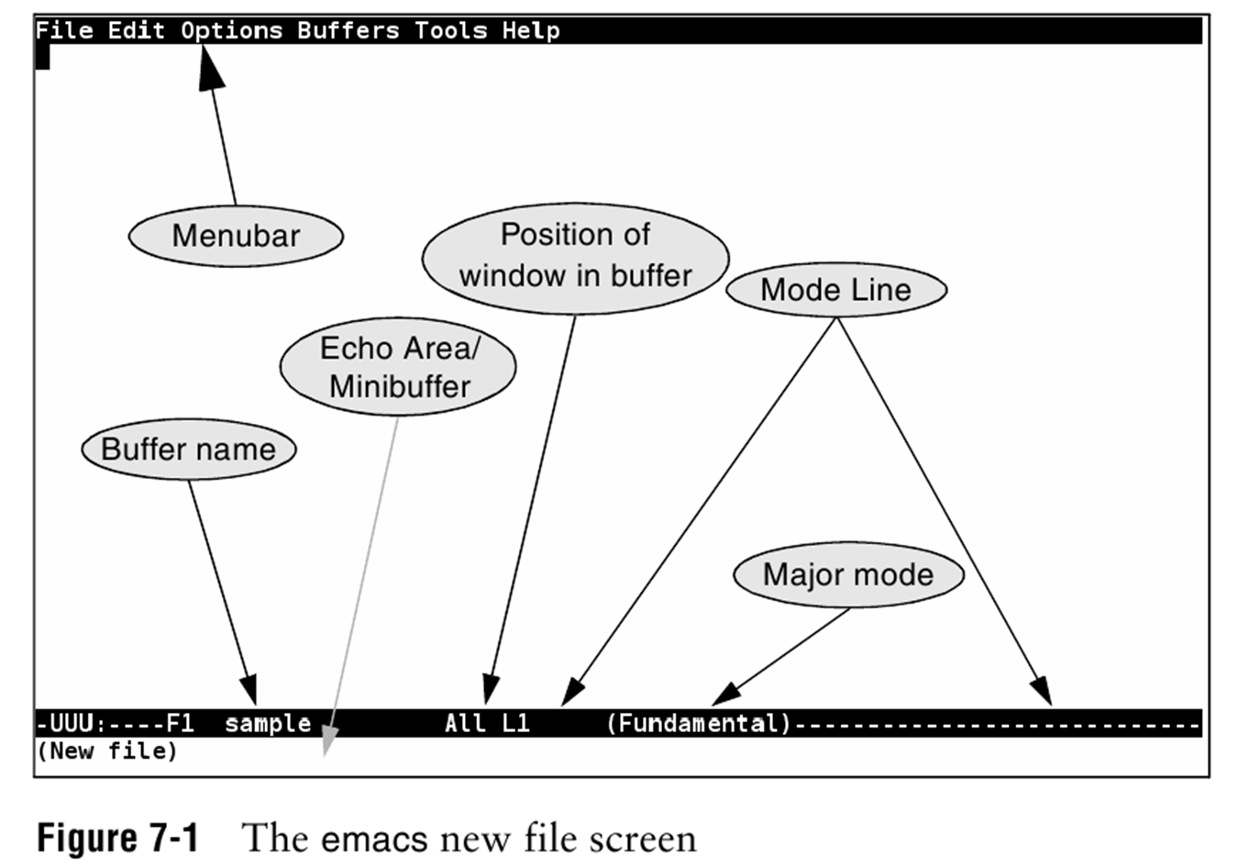
Getting Started
The emacs workarea

Slide 9
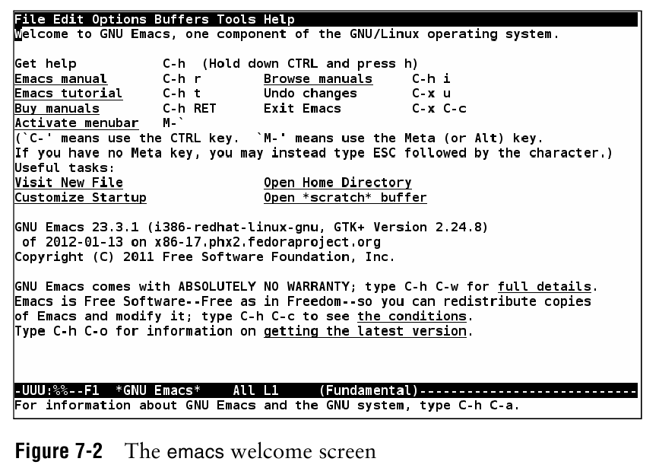
Getting Started

Slide 10
Getting Started
emacs commands
  Always start with either the
  Ctrl key identified as C- or the
  Alt key sometimes called the “Meta key” identified as M-
  After the C-/M- one or more keys are used to identify the command you want.
We will use C- M- in this presentation

Slide 11
Navigation
On most systems the arrow and Page-up Page-Down keys work as expected
The Ctrl equivalents
  M-v – Page-up
  C-v – Page-down
  C-p – Previous line
  C-n – Next line

Slide 12
Navigation
The Ctrl equivalents
  C-b – Backward 1 character
  C-f – Forward 1 character
  C-l – Center screen at cursor
All screen navigation overlaps 2 lines
All line navigation overlaps by ½ screen

Slide 13
Navigation
Larger Cursor movements
  M-b – Backward 1 word
  M-f – Forward 1 word
  C-a – Beginning of Line
  C-e – End of Line
  M-a – Beginning of Sentence
  M-e – End of Sentence

Slide 14
Navigation
Larger Cursor movements
  M-{ – Beginning of Paragraph
  M-} – End of Paragraph
  M-< – Beginning of File
  M-> – End of File
Repeating commands
  C-u nnn – Repeat nnn times
  C-u 10 C-n – Next line 10 times

Slide 15
Navigation
Stop, I wanna get off!
C-g
Undo, what I did
C-_
Undo, the Undo
C-f C-_

Slide 16
Entering text
Start typing, by default
  Characters are inserted at the cursor pushing following characters to the right
  Automatic word wrap is on
  Pressing the insert key toggles between insert and overwrite modes
  Delete – removes character at cursor
  Backspace – removes character before

Slide 17
Copy, Paste & Deleting text
Point – current edit position in the buffer
(wherever the cursor is)
Mark – last remembered buffer position
  C-@ sets the mark equal to the point
  C-x x toggles between the mark & point
  Region – the contiguous characters between Point and Mark

Slide 18
Cut, Copy, Paste text
Kill (cut / copy) - places the text in the Kill Ring for later retrieval
  C-w – Cuts the region to the Kill Ring
  M-w – Copies the region to the Kill Ring
  C-y – Yanks the last Kill into the buffer at Point
  M-y – Erases previous yank inserts next Kill entry into the buffer at Point

Slide 19
Cut, Copy, Paste text
  M-z chr – Kills from point up to the next chr
Kill vs Deleting
  Only killed text can be yanked
  Both killed and deleted text respond the same when you use the undo command.

Slide 20
Files – Visiting & Saving
When you “Visit” a file or files emacs:
  Reads each file into a buffer
  Allows you to edit the buffer(s)
  And usually replaces the original file(s)
  C-x C-f – prompts for the filename

Slide 21
Files – Visiting & Saving
Saving files
  When you save a buffer, you save the file
  C-x C-s – save the current buffer & file
  C-x s – prompts to save modified buffers
  C-x k – prompts & deletes, buffer not saved
  C-x C-W – prompts for filename and saves as new file

Slide 22
Buffer list
All buffers yours and emacs
  Your session starts with two buffers
    *scratch* – temporary scratch pad
    *messages * – eamcs messages for you
  C-x C-b – display the emacs *Buffer List*
  C-x b – prompts for buffer name ,selects it or creates it in a window
  C-x o – cycles through all windowed buffers

Slide 23
Buffer list
Managing buffer windows
  All windowed buffers can be displayed
  Manage the windows
    C-x 0 – delete current window
    C-x 1 – delete all windows except current
    C-x 2 – split current window vertically
    C-x 3 – split current window horizontally
    C-x 4b – window named buffer
    C-x 4f – window named filename
    C-x o – cycle through all windows

